Slide 1
Development of an AC power adapter controllable by Bluetooth or Wi-Fi
BY:
Opeyeoluwa Olanipekun
Testimony Adams
SUPERVISOR: George B. OkOROafor

Slide 2
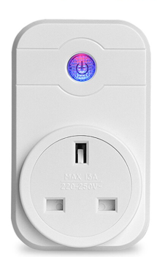
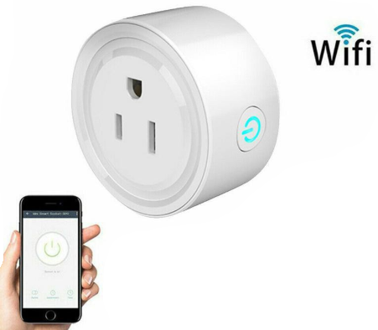
Project Description
This project is designed to modify an already existing AC Power adapter and improve its features such that any device powered through it can be controlled from a mobile device using Bluetooth or Wi-fi.

Slide 3
Project Objectives
The Adapter should be controlled using a mobile device via Bluetooth or Wi-fi from anywhere in the world.
It should accommodate 13 amps of current and 240V ac, 50Hz.
It should be controlled manually and automatically.
The operation of the device should not be hampered by power outage.
The hardware should possess friendly aesthetics and easy user experience.
A notification should be sent to the phone of the user to alert on restoration of power from the national grid.

Slide 4
Project Components
ESP32
Relay
Arduino board
Breadboard
Jumper wires
AC Adapter
Mobile device
Rechargeable Batteries
AC to DC Converter

Slide 5
Research Design and Methodology

Slide 6
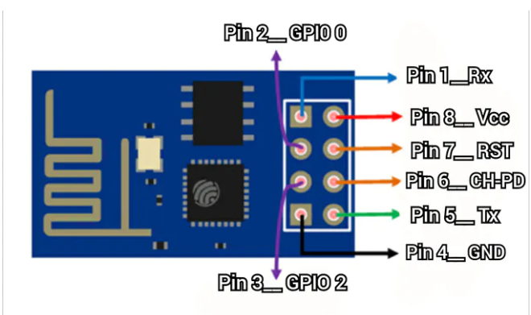
What is ESP8266 and how does it work?
ESP8266 is a low-cost Wi-Fi module that belongs to ESP's family which can be used to control the device anywhere in the world.
The maximum working voltage of the module is 3.3v. Anything higher will fry the module.

Slide 7
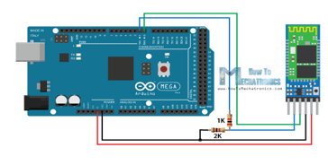

HC-05 Bluetooth Module
Bluetooth module RX (Receive Pin, which supports only 3.3V) needs to be connected through a voltage divider in order not to burn the module.

Slide 8
User Interface (Blynk App)
Blynk App
Blynk App Server
Wi-Fi
Bluetooth
ESP8266
HC-05
AC Adapter
Notes:
The ESP8266 is connected to the nearby Wi-Fi hotspot or Bluetooth that allows it to access the internet and sends data to the Blynk server along with authentication code.
An authentication code is then sent to the app that has the same authentication code and then, the app receives the data to create a secure connection between the app and the ESP8266.
The data from the Blynk app is sent to the Blynk server along with the authentication code and since the ESP8266 has the same authentication code which is connected with the Blynk server, the server identifies the matching code and data is sent to the corresponding ESP8266.

Slide 9
Timeline
Get familiar with Arduino board and IDE, ESP8266, Relay and HC-05
Understand the workings of Blynk App
Write code to power AC Adapter with Bluetooth and Wi-Fi
Integrate working parts

Slide 10
Conclusion
The practical potential of this project is huge as it is standalone rather than a dedicated device. It will be helpful to people with physical disabilities related to restricted motion.

Slide 11
Thank You

